Slide 1
Gone Phishing
Alex, Tom, Dave, Nishan, Khasad, Sebastian

Slide 2
Cueh_HMAc_1
Tasked with testing the security of an HMAC implementation (CUEH_HMAC_1)
Challenged to decide if it was fit for purpose

Slide 3
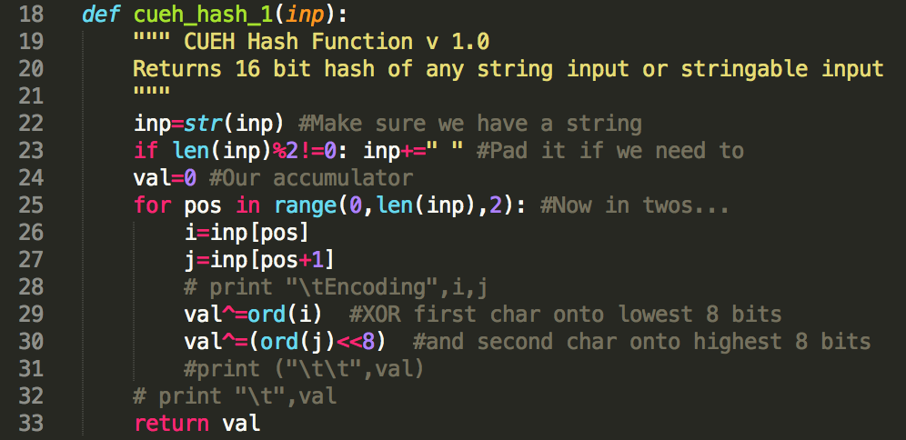
Cueh_HMAc_1
First step to read and analyse the code (shocking, I know)
cueh_hash_1 is the only bit of the protocol that we could manipulate
The flaw – length extension attack

Slide 4
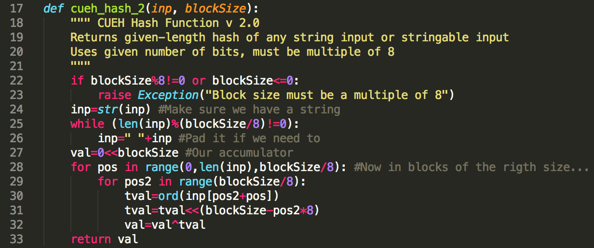
hmac_2
Variable block size
Makes length extension attack slightly harder
It is still possible to get block size based on the length of the cipher

Slide 5
CUEH_HMAC SOLUTIONS
HASH TWICE
Hash twice
HASH TWICE
hash(key + hash(key + message))

Slide 6
RASPBERRY Pi – Digital Forensics
Given compromised Raspberry Pi image
Tasked to find out how it was hacked
Find evidence of this attack

Slide 7
RASPBERRY Pi – Methodology
We remained in accordance with the ACPO principles
Looked at software differences to blank Raspberry Pi

Slide 8
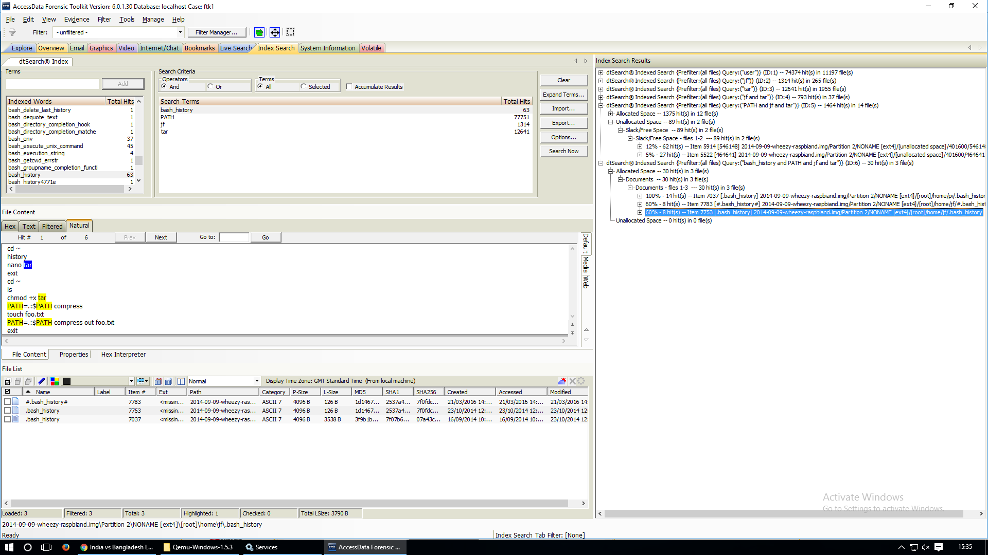
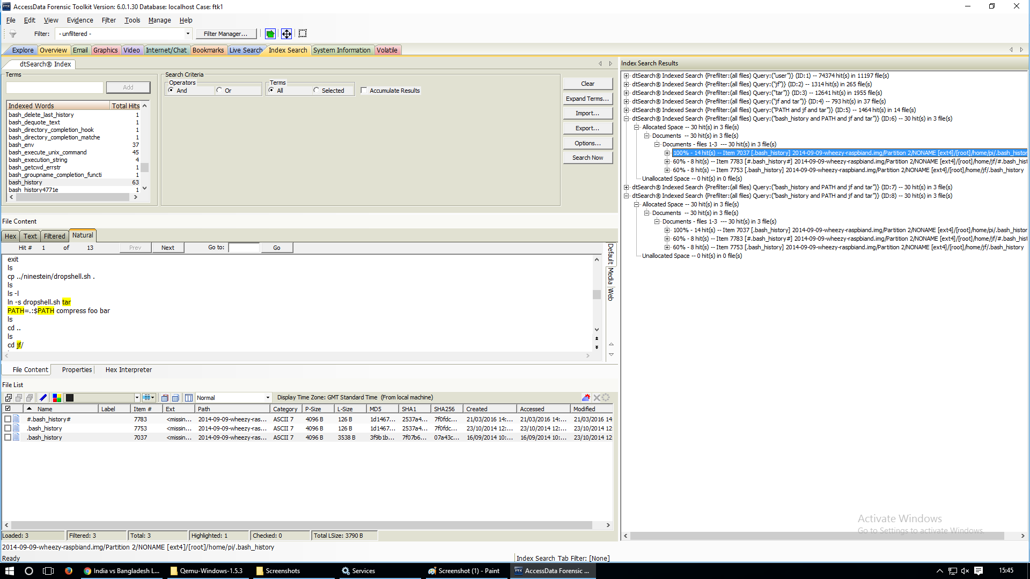

RASPBERRY Pi – Evidence
Initial information gathered suggested
Mostly examined log files

Slide 9
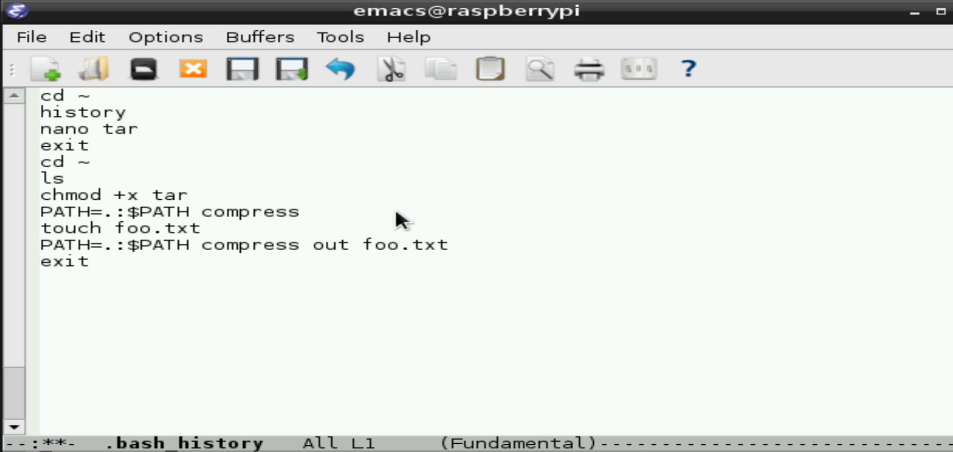
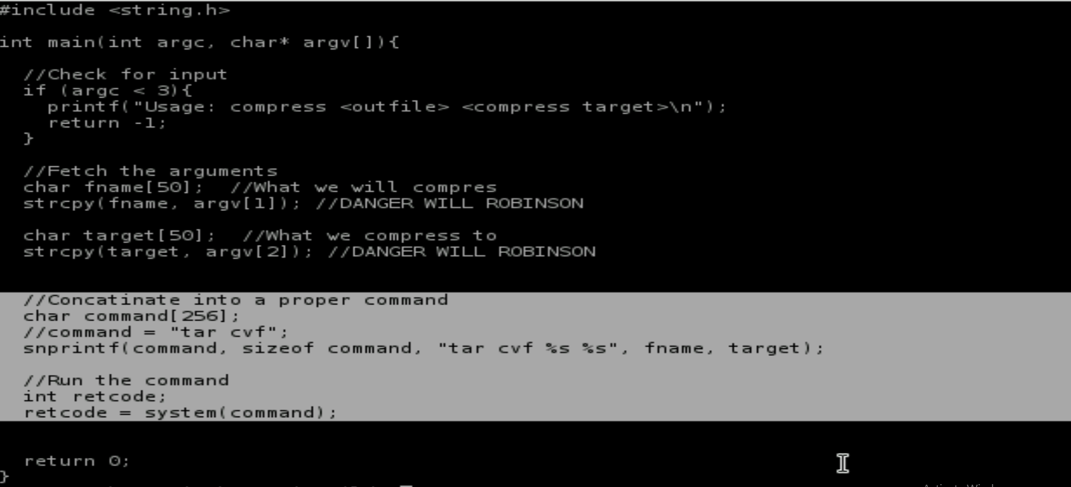
RASPBERRY Pi – Evidence

Slide 10
DIAMOND HOUSE
Tasked with performing penetration tests on the server image
Finding as many vulnerabilities as possible
Collect evidence of the attacks

Slide 11
DIAMOND HOUSE - RECONNAISSANCE
Set up virtual network with the server and Kali Linux
Used nmap to discover the IP address of Diamond House
Used nmap again to discover the open ports
Used openvas to perform an in-depth scan of the services

Slide 12
DIAMOND HOUSE – PARTY TIME
Listed vulnerabilities and worked on them individually
Developed automation tools for the exploits

Slide 13
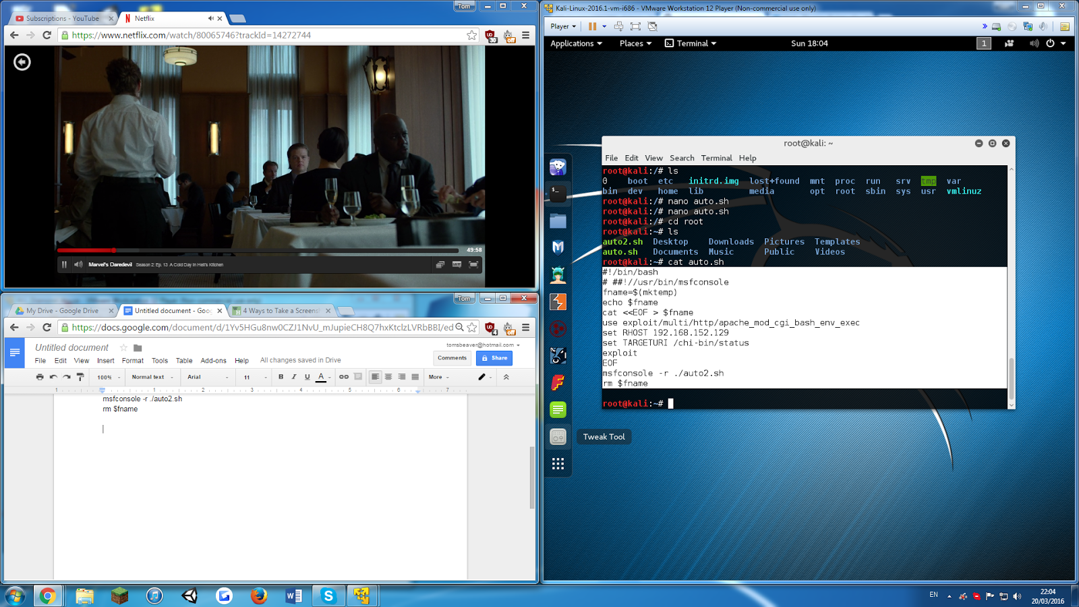
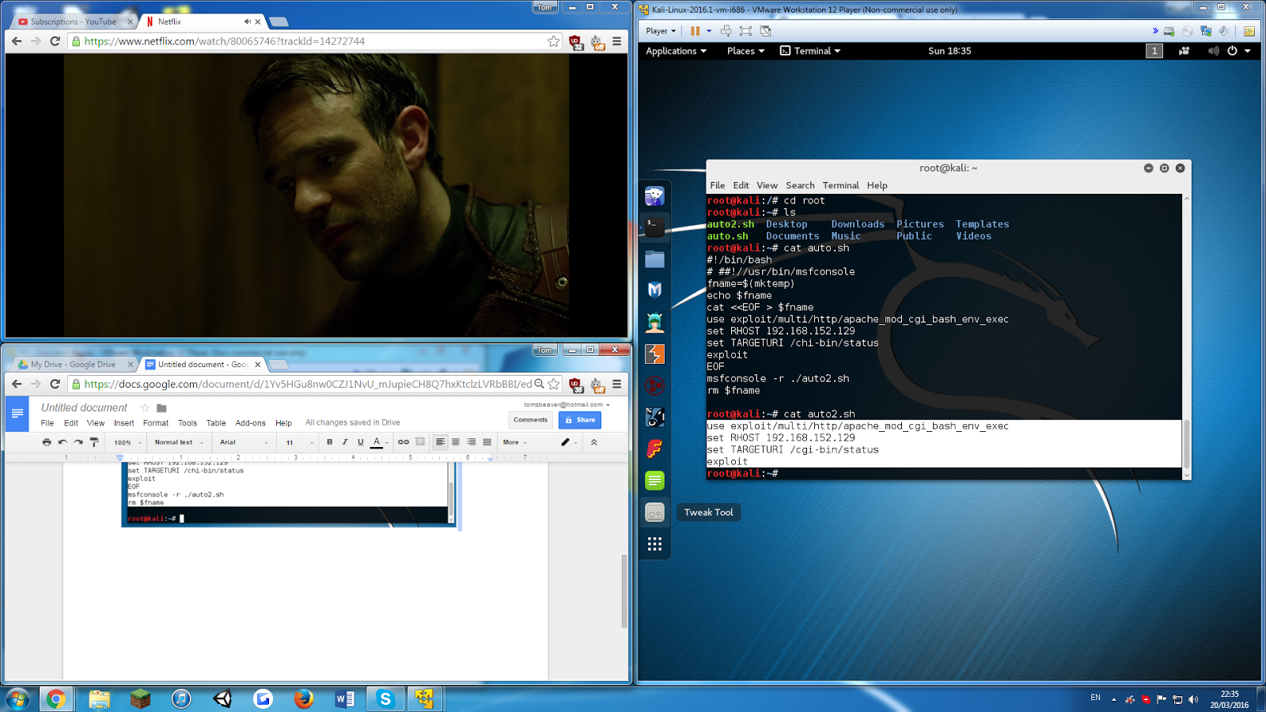
DIAMOND HOUSE – SHELLSHOCK
CVE-2014-6271
This exploits /cgi-bin/status which is used by Apache
Executes arbitrary code without correct permissions

Slide 14
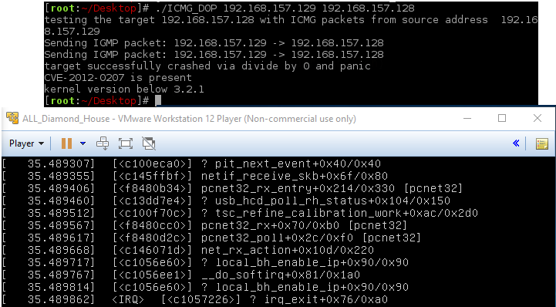
DIAMOND HOUSE – divide by zero error…

Slide 15
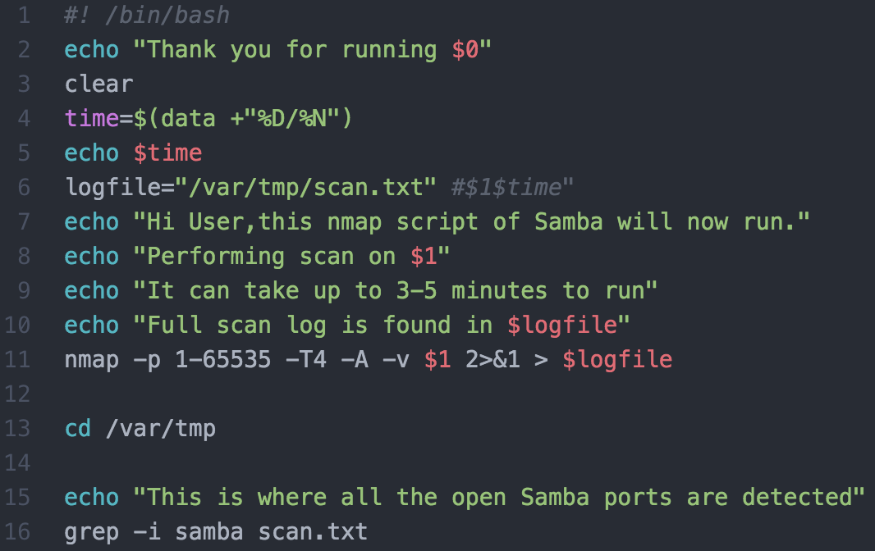
DIAMOND HOUSE – SAMBA
Script scans for open Samba ports
It is a service rather than showing the vulnerabilities

Slide 16
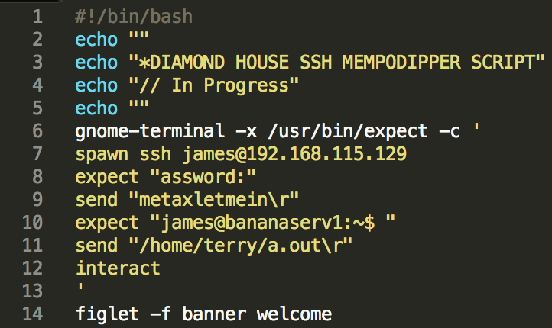
DIAMOND HOUSE – MEMPODIPPER
Mempodipper CVE-2012-0056
Mempodipper opens a new shell with root capabilities
Script logs into server with ssh
Runs Mempodipper

Slide 17
RANSOMWARE - Research
Normal ransomware
‘CryptoLocker’ ransomware

Slide 18
RANSOMWARE - SOLUTION
Check for suspicious write operations
Ask user for confirmation upon detection
Halt all write operations until user confirmation
If not confirmed, system enters protective state or returns to previous safe backup

Slide 19
Summary – what did we develop?
5 Automated tools for Diamond House
HMAC length extension attack
Vulnerability scan reports

Slide 20
Summary – Learning as a group
Professional skills
Pen testing
Digital Forensics
Log analysis
Tool use
Documentation skills

